Slide 1




虚 拟 A I, 未 来 可 期
虚拟形象机器人

Slide 2
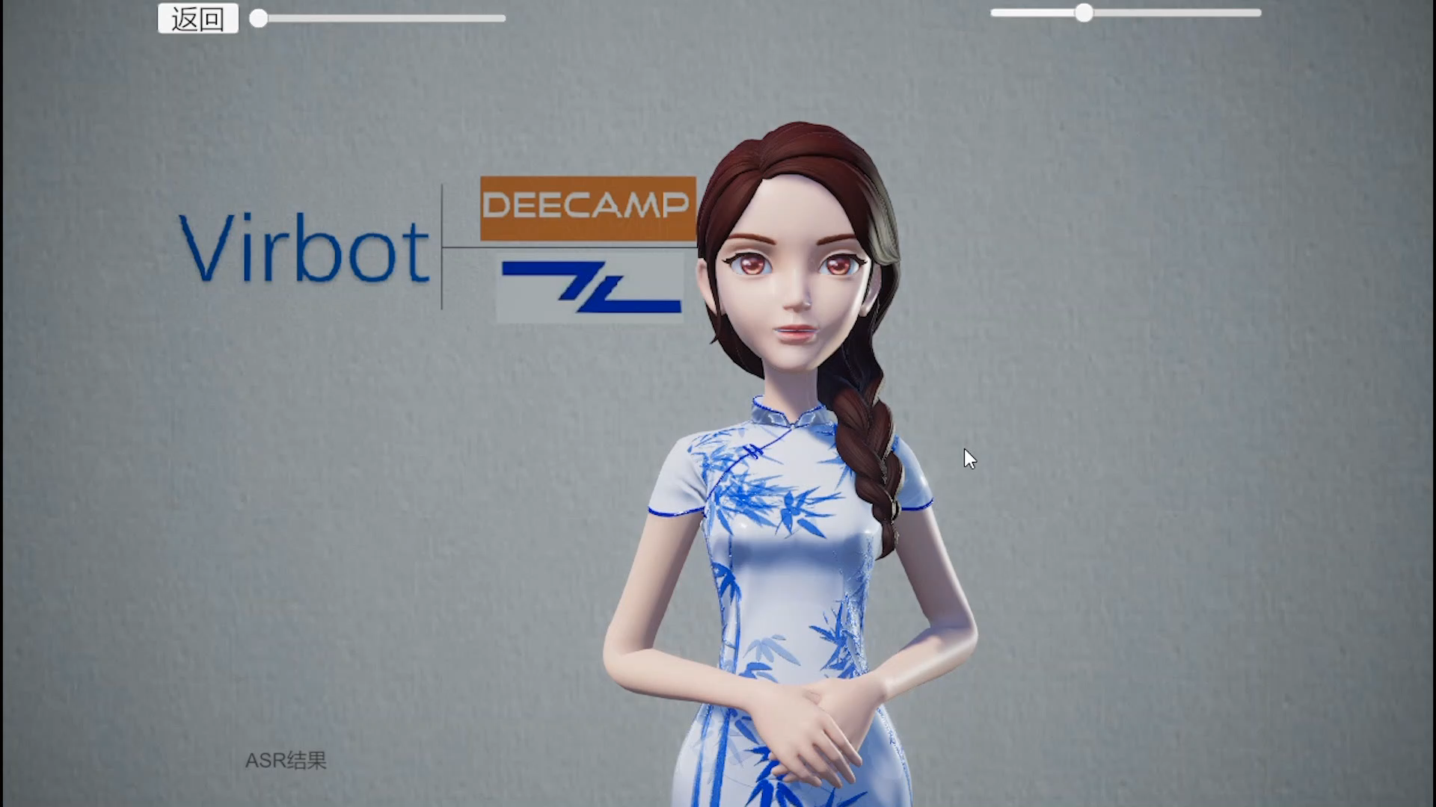
LEARN MORE

Slide 3
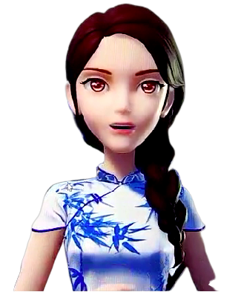
Introduction
Demonstration
What is 3D digital man
Zhuiyi, Baidu
Sogou, Iflytek
This is Xiaoyi’s show time
Online Experience
live interaction
Algorithm
Prospection
How was Xiaoyi born
Ation & Lip&&&&&& &inference
Dialogue management
How virbot will change our life
Intelligent Customer Service
Virtual Anchor

Slide 4
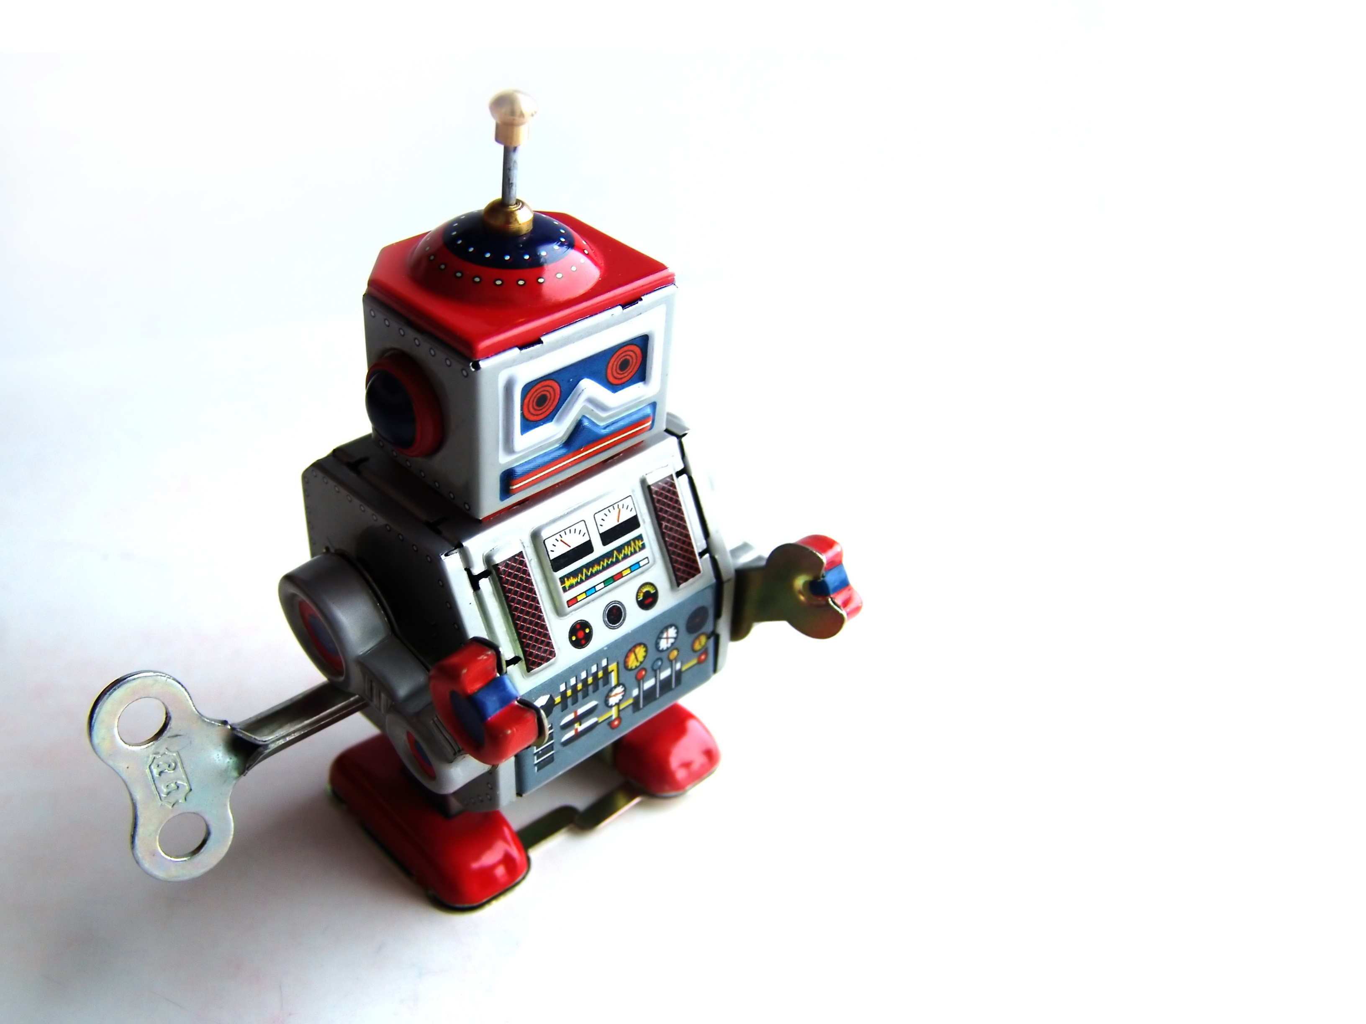
I INTORDUCTION

Slide 5
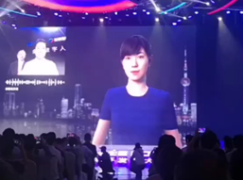


V I R B O T A S Y O U H O P E
VIRTUAL IMAGE ROBOT
Virtual robot is an anthropomorphic robot service that combines speech synthesis, lip synthesis, facial expression synthesis, body movement prediction and other artificial intelligence technologies.
2D
3D
2D
2D virtual robot
Natural expression, difficult modeling, few application scenarios
3D virtual robot
Natural expression, simple modeling and many application scenarios
2D virtual robot
Natural expression, difficult modeling, few application scenarios

Slide 6



V I R B O T A S Y O U H O P E
APPLICATION SCENARIOS
Virtual image robots has a wide range of application scenarios , such as virtual anchor, online education, family assistant, customer service, and great commercial liquidity potential.
V
)O
F
C
Virtual Anchor
Online Education
Family Assistant
Customer Service
.

Slide 7
V I R B O T A S Y O U H O P E
TECHNICAL DIFFICULTIES
Virtual Image Robot is an advanced technology and has a wide range of business scenarios, but there are still many difficulties in lip fitting and interactive management.
10%
60%
30%
ACTION
LIP FITTING
INTERACTION
Make action and voice
more harmonious
Make lips smoother and
more authentic
Make dialogue smarter and
more accurate

Slide 8
V I R B O T A S Y O U H O P E
SOLUTION
LIPPING INFERENCE
Based on deep learning, using attention mechanism and two-way LSTM network structure, achieves the perfect mapping from audio features to lip features.
ACTION INFERENCE
Based on the custom rule strategy, we can perceive the semantic information and make appropriate actions at the right time, which is smooth and natural.
DIALOGUE MANAGEMENT
Based on ASR system, semantic analysis and big data technology. ASR results are used to search database to realize human-computer interaction and natural dialogue.

Slide 9
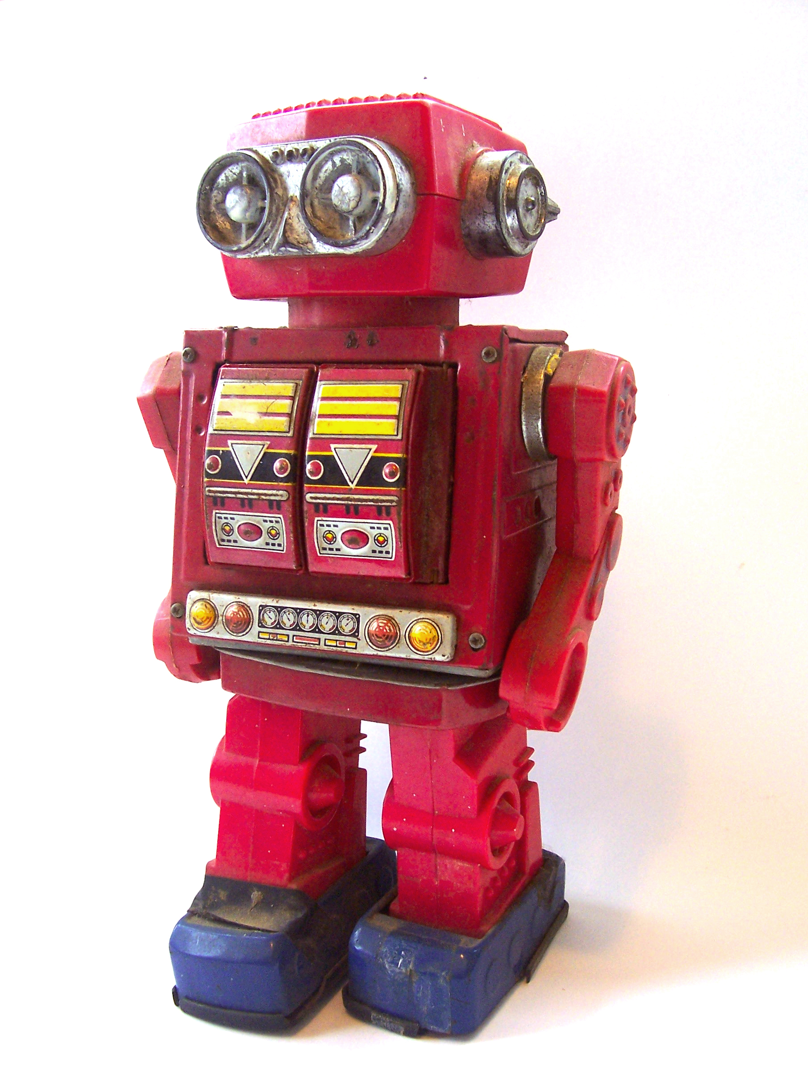
II MODEL

Slide 10
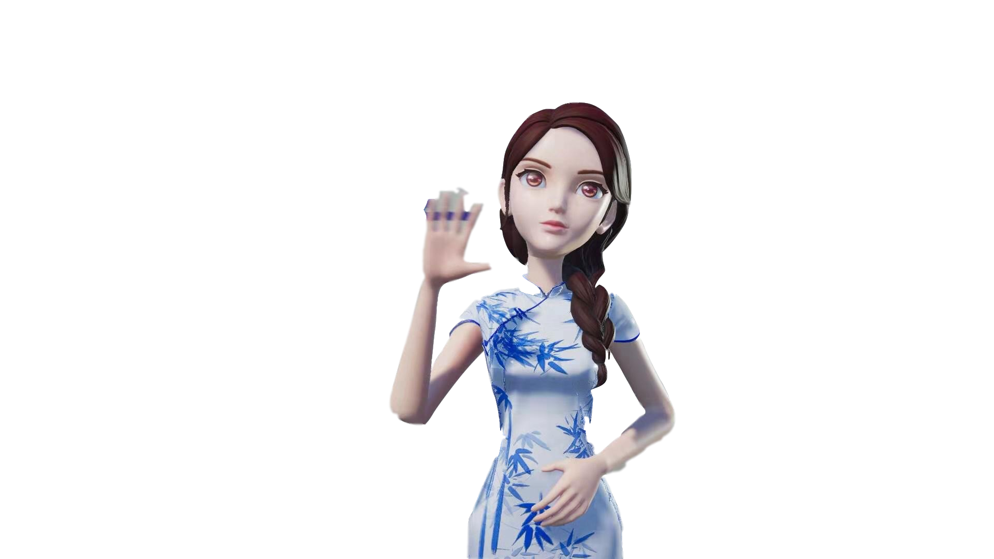

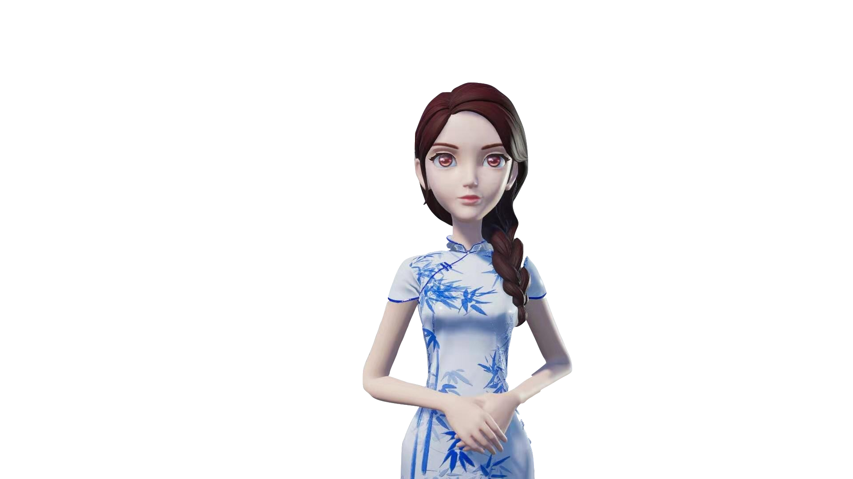

V I R B O T A S Y O U H O P E
ACTION
INFERENCE
RULE SEMENTIC
ACTION
Based on the custom rule strategy, we can perceive the semantic information and make appropriate actions at the right time, which is smooth and natural.

Slide 11
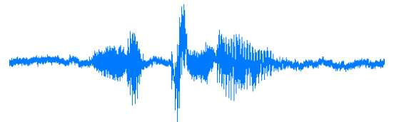
V I R B O T A S Y O U H O P E
LIP INFERENCE
Based on deep learning, using attention mechanism and two-way LSTM network structure, achieves the perfect mapping from audio features to lip features.
Feature
Extraction
Audio
Features
Facial
Parameters
Unity
Blendshape
VBOT
STEP ONE
STEP TWO
STEP THREE
STEP FOUR
STEP FIVE
Using TTS, MELP extracts audio features
We get 29-dimensional audio features.
VBOT Maps Audio Features to Labial Features
We use 30 facial feature points as lip features
Character Modeling Using Unity blend shapes

Slide 12

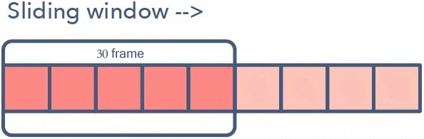
DATA ARGUMENT
Sliding window is used for data segmentation, which increases the fluency of lip shape.
Step Segmentation of Data to Increase Data Quantity and Improve Fitting Effect
SLIDE WINDOW
STEP SEGMENTATION

Slide 13
VBOT
Output
chuang
xin gong chang
Sequence Loss Layer
...... chuang ......
Semantic Layer
ch
u
a
ng
Downsamping Layer
Input

Slide 14
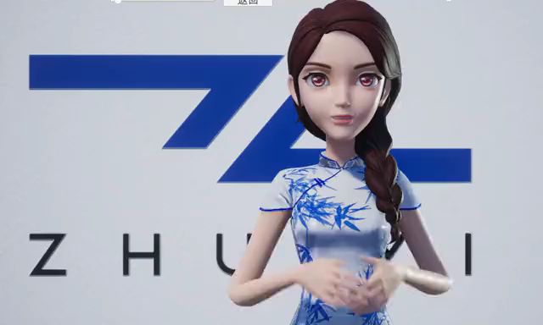
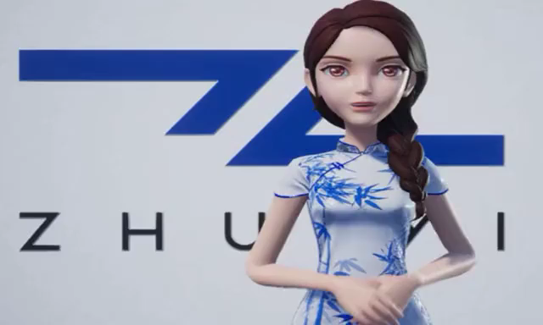
Learn local features to increase the range of body movements,
make lip movement more obvious and true
Smooth the features learned from the lower layers , and connect the features from the global perspective to avoid shaking
WITHOUT
DOWNSAMPLING LAYER
WITHOUT
SEQUENCE LOSS LAYER

Slide 15

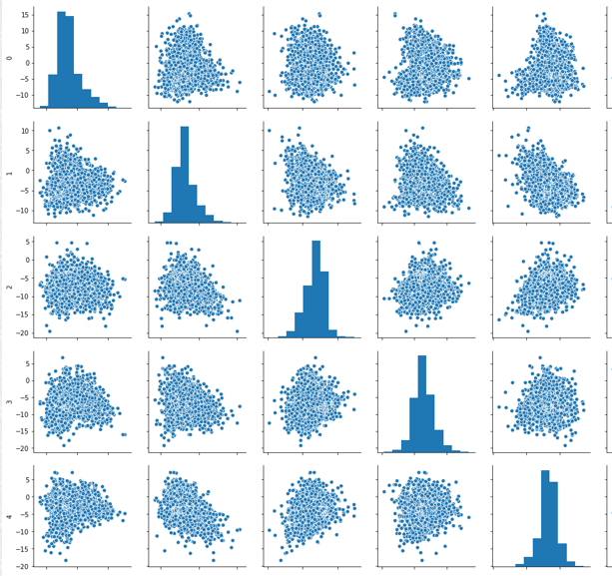
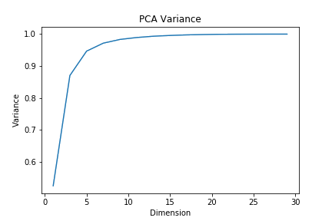
V I R B O T A S Y O U H O P E
LIP INFERENCE
Based on deep learning, using attention mechanism and two-way LSTM network structure, achieves the perfect mapping from audio features to lip features.
CORRELATION
PCA ACCURACY
CORRELATION

Slide 16
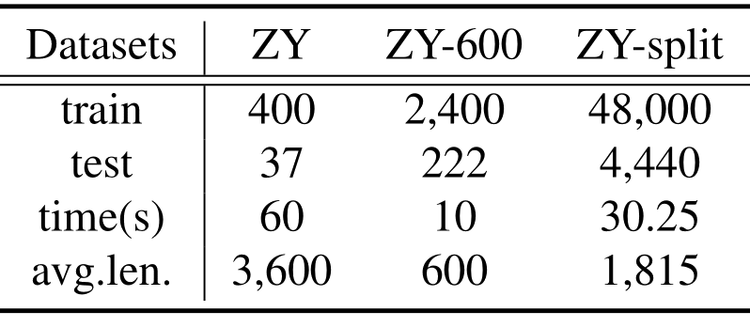
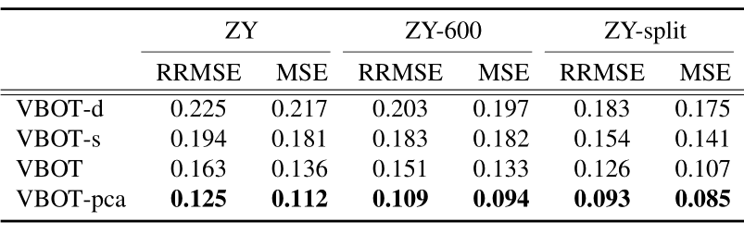
V I R B O T A S Y O U H O P E
PERFORMANCE
Table 1: Statistics of the experiment datasets
Table 2: The overall performance over three dataset

Slide 17

V I R B O T A S Y O U H O P E
DIALOGUE MANAGEMENT
Based on ASR system, semantic analysis and big data technology. ASR results are used to search database to realize human-computer interaction and natural dialogue.
step 2
Server
Using WebSocket
to get text
step 4
Semantic
Semantic Understanding using NLP
step 6
Interaction
Interaction Based on Unity 3D
step 1
Voice
Sound Acquisition
Real Audio
step 3
ASR
Converting voice to text
step 5
VirBot
Generating image and voice through VirBot

Slide 18

Ⅲ DEMONSTRATION

Slide 19
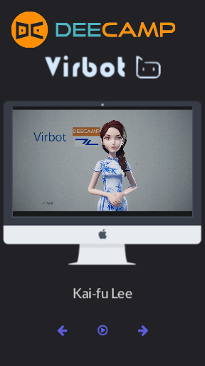

V I R B O T A S Y O U H O P E
DEMONSTRATION
Song RAP Poetry
Chinese English Cantonese
cocoyun.cn

Slide 20
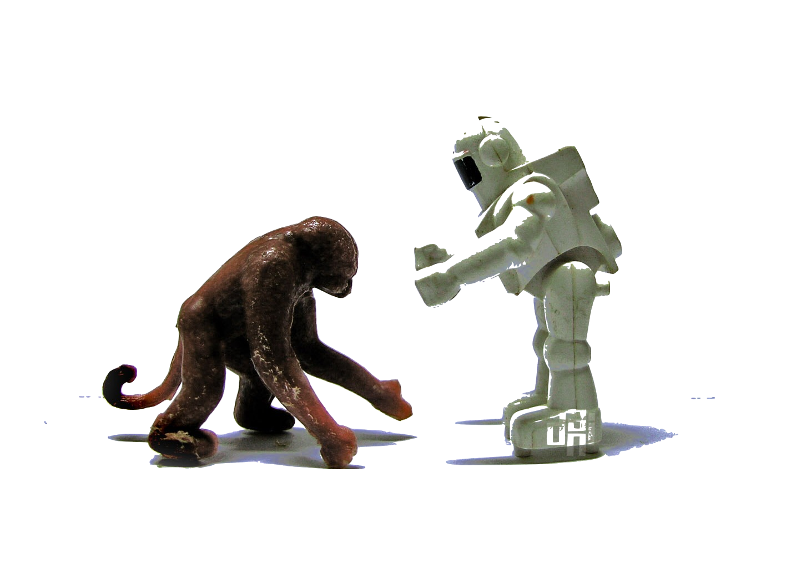
Ⅳ PROSPECTION

Slide 21
V I R B O T A S Y O U H O P E
PROSPECTION
We will continue to improve the product, add gesture recognition, semantic understanding, and even move it to the mobile side, making it your smart assistant.
ACTION INFERENCE
MOBILE APP
Intelligent Dialogue
A company is an association or collection of individuals, whether natural persons, legal persons, or a
A company is an association or collection of individuals, whether natural persons, legal persons, or a
A company is an association or collection of individuals, whether natural persons, legal persons, or a
cocoyun.cn

Slide 22


Slide 23
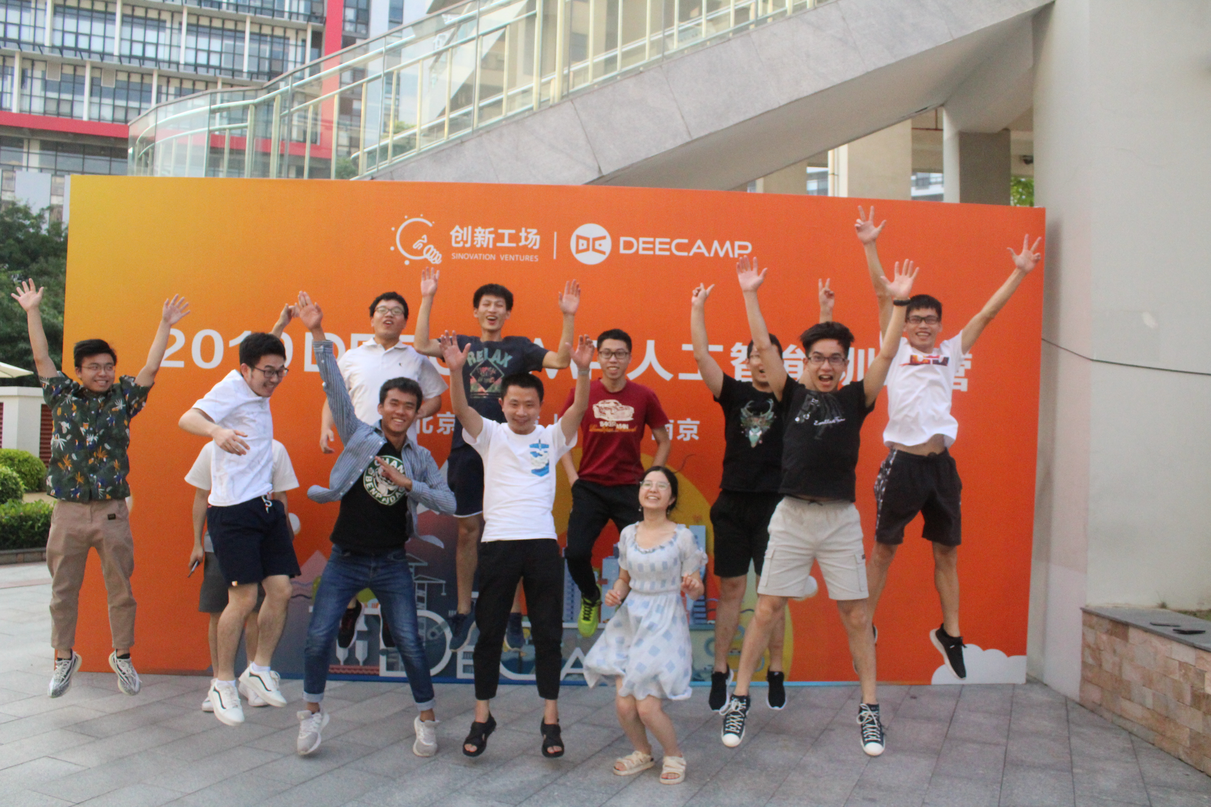


V I R B O T A S Y O U H O P E
ACKNOWLEDGEMENT
cocoyun.cn

